Slide 1
PRESCRIPTION LABEL READING
DETAILED PROJECT REPORT
By :
Asaif Ali
Hiren Thakkar
Khushwant Singh
Sanket Maheta
Shritama Sengupta
To:
I-Neuron

Slide 2
PROJECT DETAILS
PROJECT TITLE | Prescription Label Reading
TECHNOLOGY | Deep Learning Technology (Computer Vision)
DOMAIN | Healthcare
PROJECT DIFFICULTY LEVEL | Intermediate
PROGRAMMING LANGUAGE USED | PYTHON
TOOLS USED | Google Colab

Slide 3
OBJECTIVE
To develop a system that recognises and identifies the text in prescriptions and reads out the names of medications and dosage limits to visually impaired patients.

Slide 4
PROBLEM STATMENT
Supporting elderly or vulnerable patients should be a priority for numerous organisations. This is notably true for those in the health care sector. Enabling voice messages can facilitate elderly individuals' comprehension of your message. Text-to-Speech can give you peace of mind by enabling you to provide superior service.
We could even send voice communications that read prescription labels, for instance. This can be quite problematic for those with reading difficulties, let alone the elderly and visually impaired. A label that speaks and is sent directly to your device makes it simple to learn everything about your medication. Additionally, dosage data can be monitored and shared with carers.

Slide 5
APPROACH
We must extract the textual information from the prescriptions and convert it to speech using OCR techniques.

Slide 6
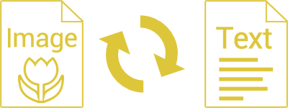
ARCHITECTURE

Slide 7
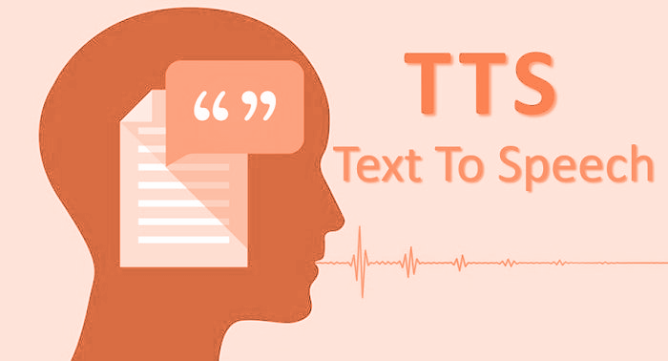

Slide 8
PROCESS
Upload a file.
Text Region Extraction.
Text extracted for recognition undergoes text binarization.
OCR is employed for text recognition.
Displays the label in text format.
The conversion of text to speech.

Slide 9
CONCLUSION
We can extract textual information from an image and convert it into dialogue in a language of your choosing.

Slide 10
Thank You

